Slide 1
What is a sock puppet account?
And why do we need one?

Slide 2
What is a sock puppet?
Also can be referred to as a burner account (“sock puppet” is more widely referenced)
This is an account that we can use that is not associated to us in any way
Uses a fake name
Can use a fake location, job, image, personality, etc.

Slide 3
Your sock puppet account
Should never contain
Depending on your use
Your real name
Real address
Real job
Real phone number
Links or associations back to you
The account can be as real as you want
As minimal as you need to browse profiles and posts

Slide 4
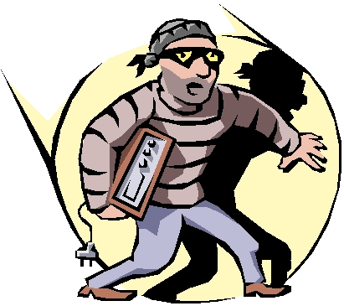
Why do we need a sock puppet account?
Depending on who we are investigating they may be dangerous
These individuals may dox us with our own information
These individuals may not want to be found
We may spook the targets if they know we are viewing their page or draw suspicion

Slide 5
Additional considerations
Always use your account in your OSINT VM
Run a clean VM for each investigation
If you run a VPN (which is generally a good idea) Facebook may flag
Your account
Using TOR is also a good option (you may run into the same issue
with Facebook)

